Slide 1
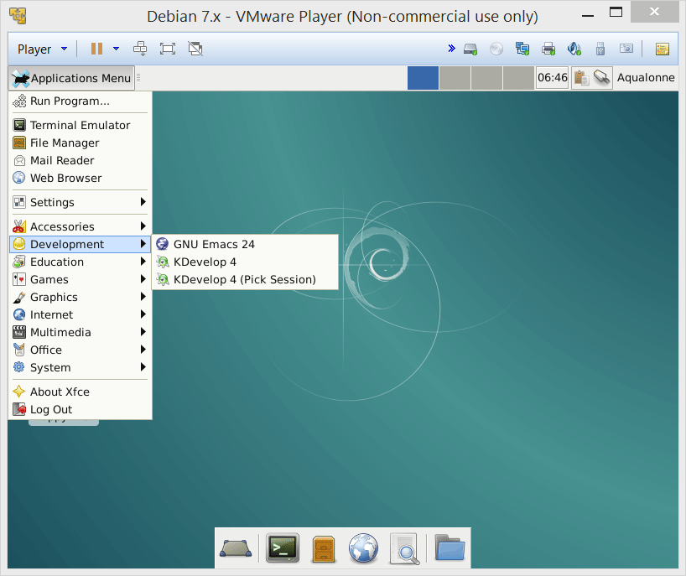
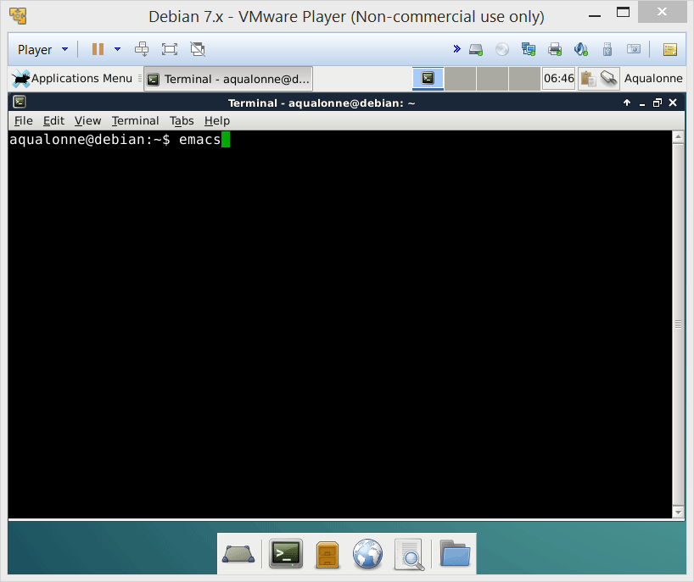
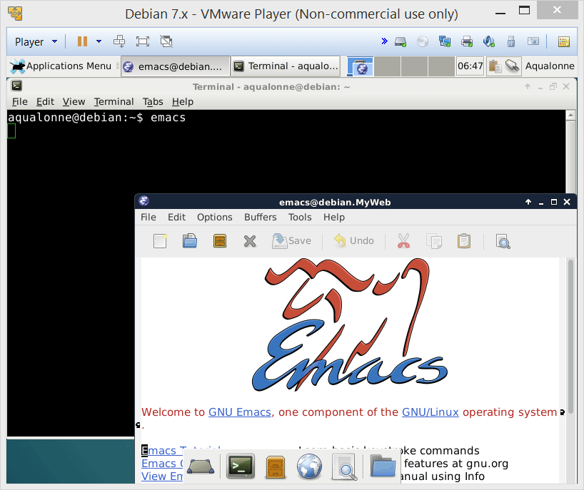
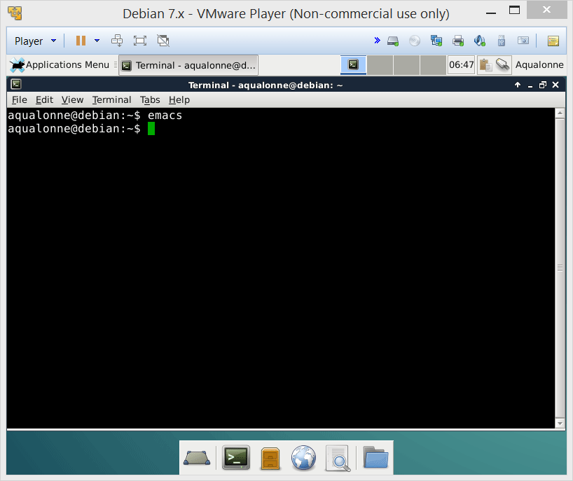

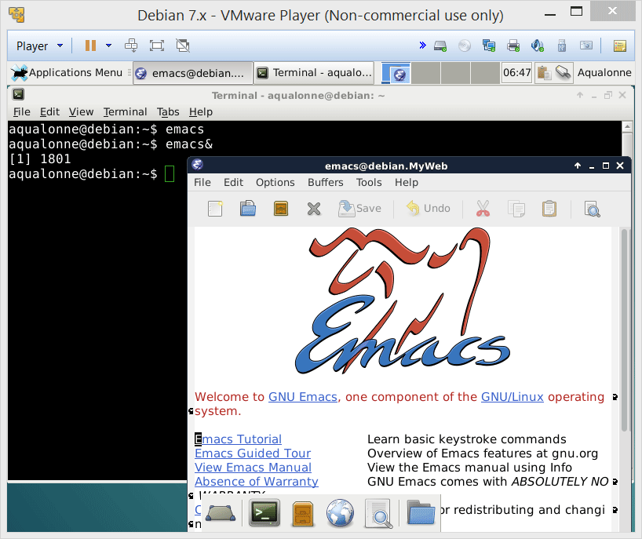
Our editor for this module: emacs
We don’t get the prompt back. Control has now been passed to Emacs, until it ends.
Emacs has a graphical user interface. It cannot reside within the shell. To detach it:
emacs&
& starts a program as an independent task
3
While and for loops

Slide 2
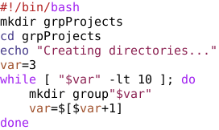

While
Typical uses:
Generating a set of numbers
Modify the template to show the value of all arguments.
1
“$#” ];
echo “${var}”
$# is the number of argument
$1, $2, ..., ${10}, ${11} is an argument
20
While and for loops

Slide 3
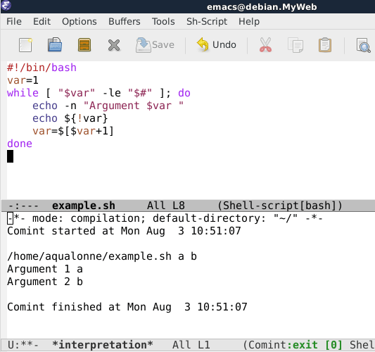

While
Typical uses:
Generating a set of numbers
Modify the template to show the value of all arguments.
Little trick: we don’t want the value of var, but of the argument that it refers to. Using ! performs an indirection.
You can read more about tricks for parameter expansions at:
http://wiki.bash-hackers.org/syntax/pe
21
While and for loops

Slide 4
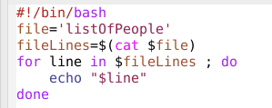
For .. in
Keep doing this for each item in that
30
While and for loops

Slide 5
For .. in
Keep doing this for each item in that
30
While and for loops

Slide 6
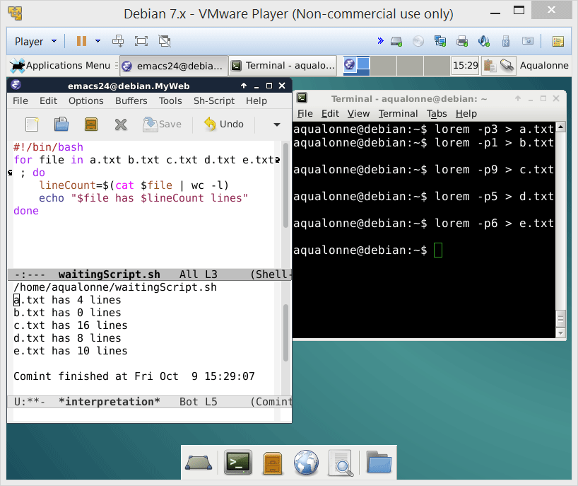
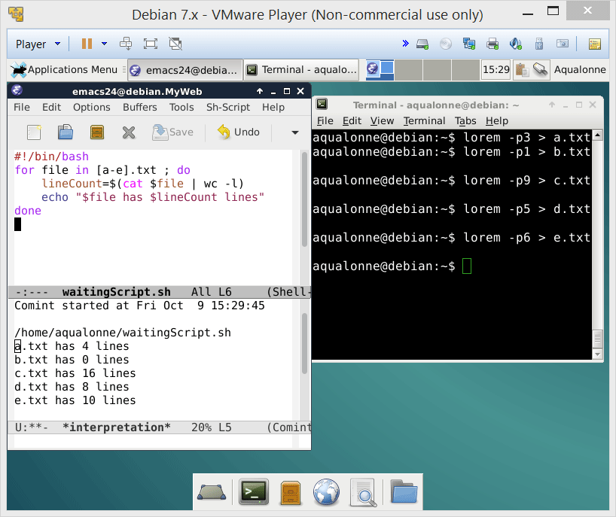
For .. in
Typical uses:
processing a set of files
for ..var.. in ..files.. ; do
32
While and for loops

Slide 7

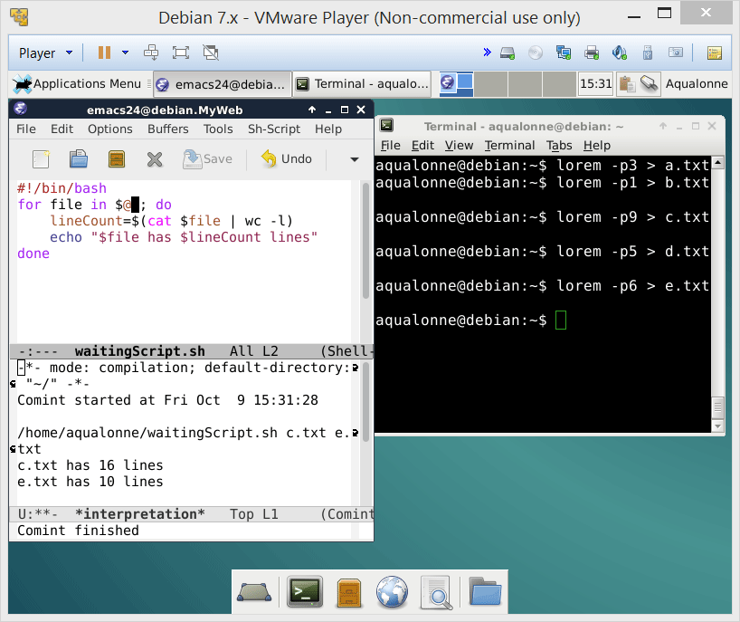
For .. in
Typical uses:
processing a set of files
for ..var.. in ..files.. ; do
processing a set of arguments
Note that if you want to start from e.g. the 2nd argument, you can use ${@:2}
for ..var.. in $@ ; do
...or if you’re feeling lazy, processing arguments is what it does by default:
for ..var.. ; do
33
While and for loops

Slide 8
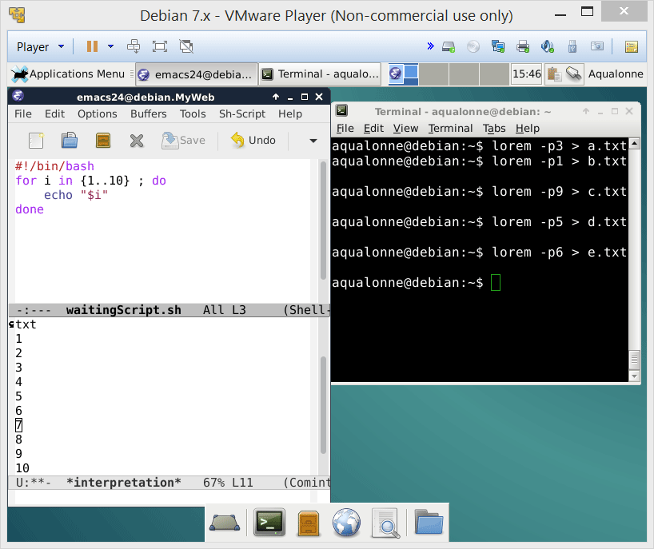
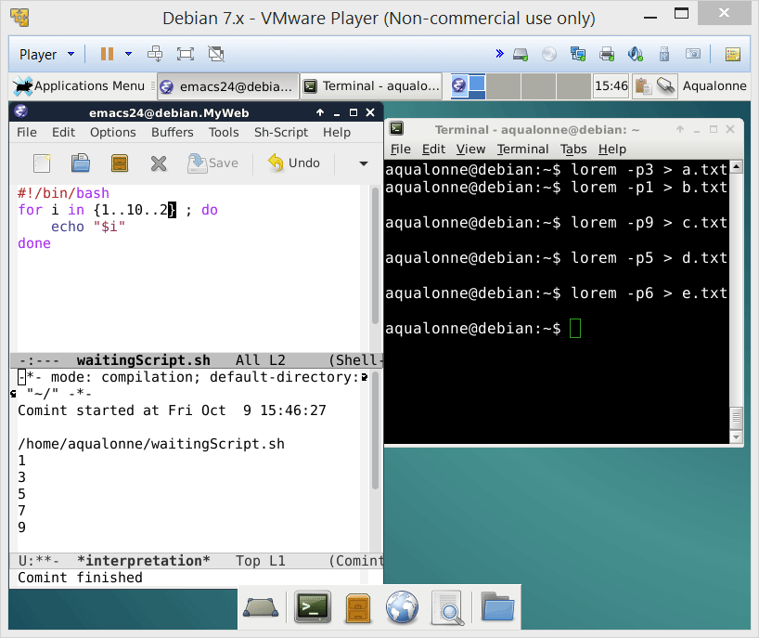
For .. in
Typical uses:
processing a set of files
for ..var.. in ..files.. ; do
processing a set of arguments
increment
start
end
for ..var.. in $@ ; do
generating a set of numbers
for i in {..set..} ; do
34
While and for loops

Slide 9

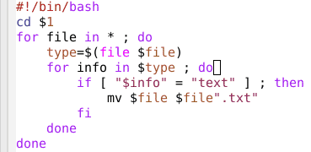
Real-world uses
For each file in the folder
Ask for the type
If the answer includes “text”
Add .txt at the end
43
While and for loops

Slide 10
Real-world uses
For each file in the folder
Ask for the type
If the answer includes “text”
Add .txt at the end
43
While and for loops

Slide 11
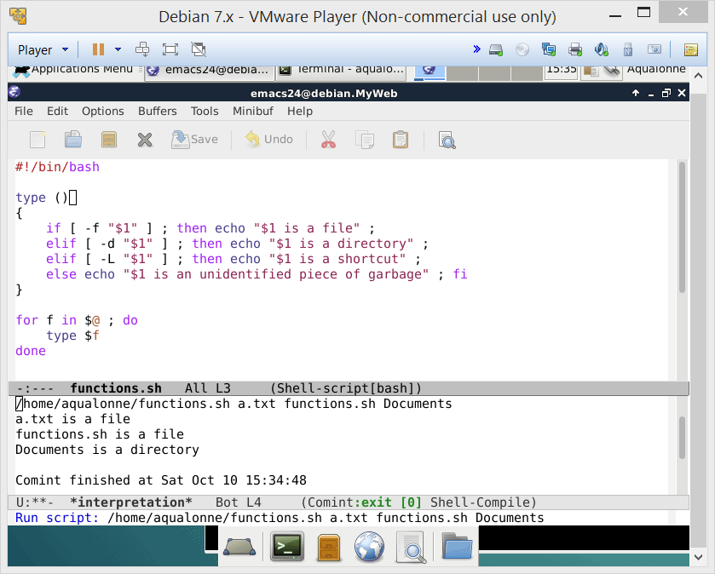
Power up your scripts with functions!
You can pass arguments to a function, and they will be accessed as $1, ...
Note that $0 is always the name of the script! For the function’s name:
${FUNCNAME[0]}
4
Functions

Slide 12
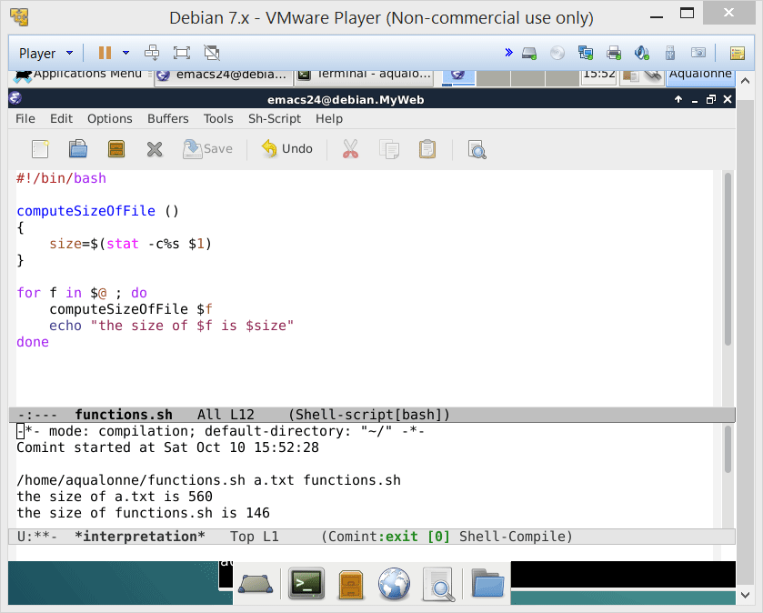

Power up your scripts with functions!
Variables made in a function are accessible in the whole script.
Do not use return to get variables’ values back!
For values
5
Functions

Slide 13
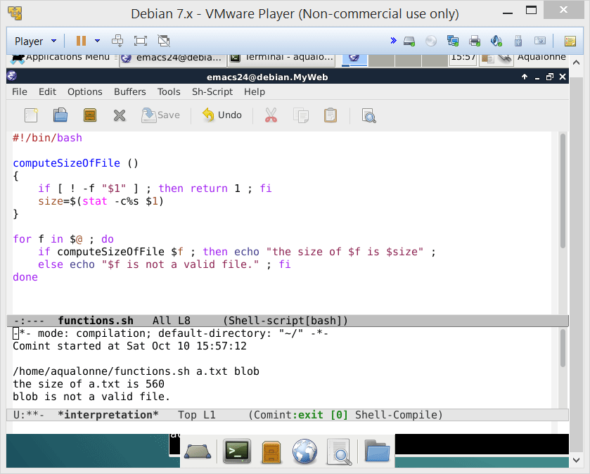
Power up your scripts with functions!
return is used only to end a function and give a status
0 for success
1 for fail
7
Functions

Slide 14
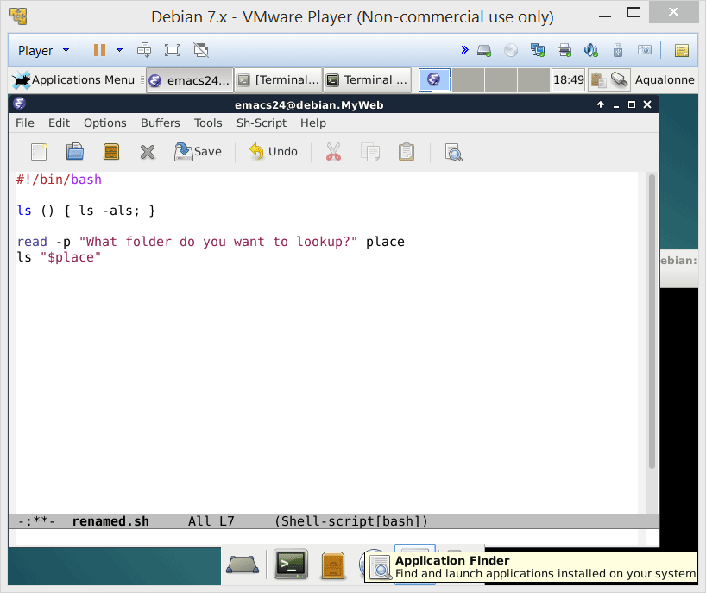
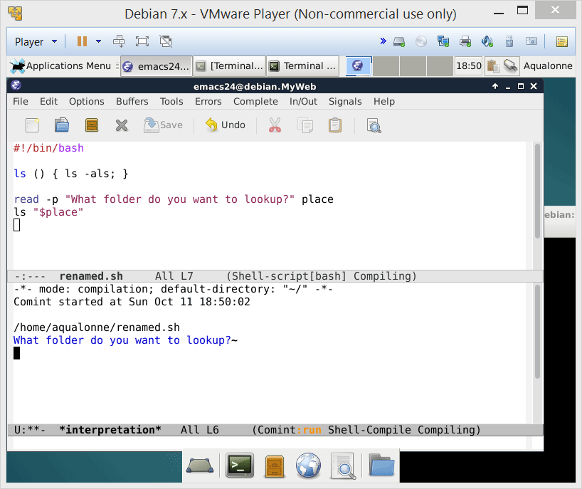
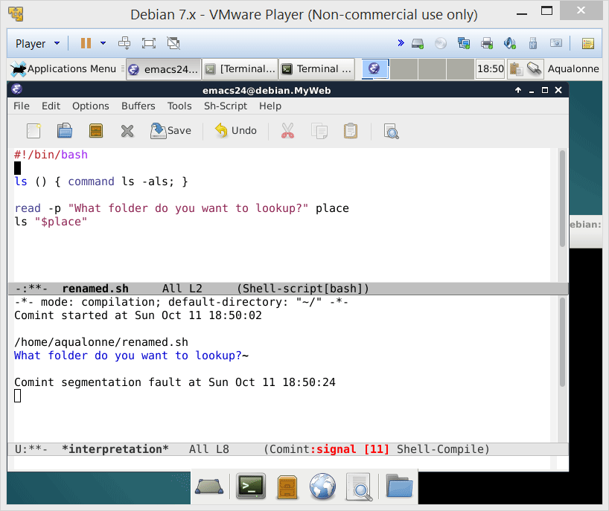
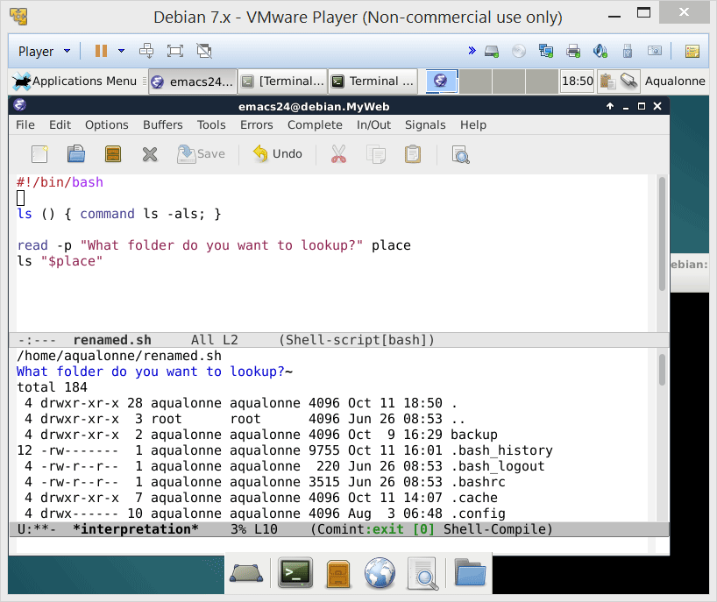

How some people use functions…
If you want to overload a command, then you need to use the command keyword
3 hours later...
23
Functions

Slide 15
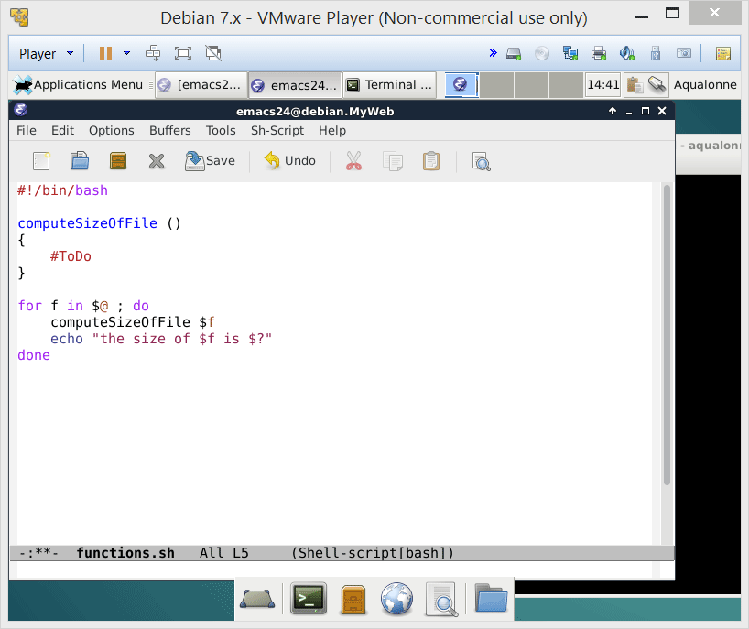
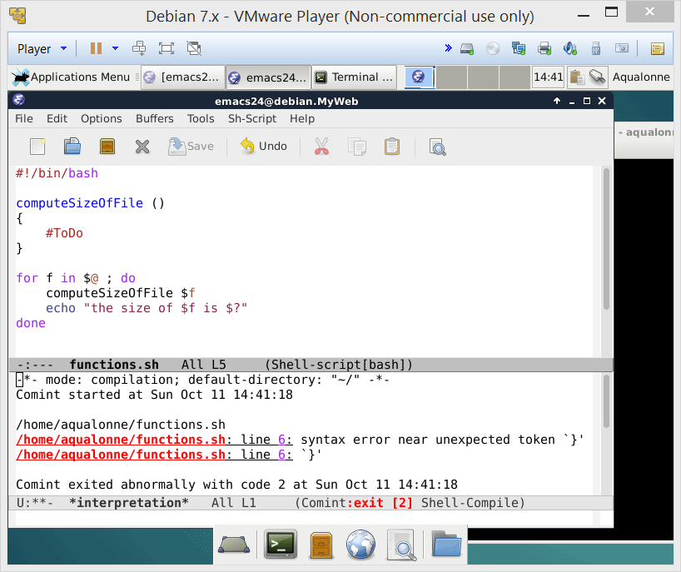
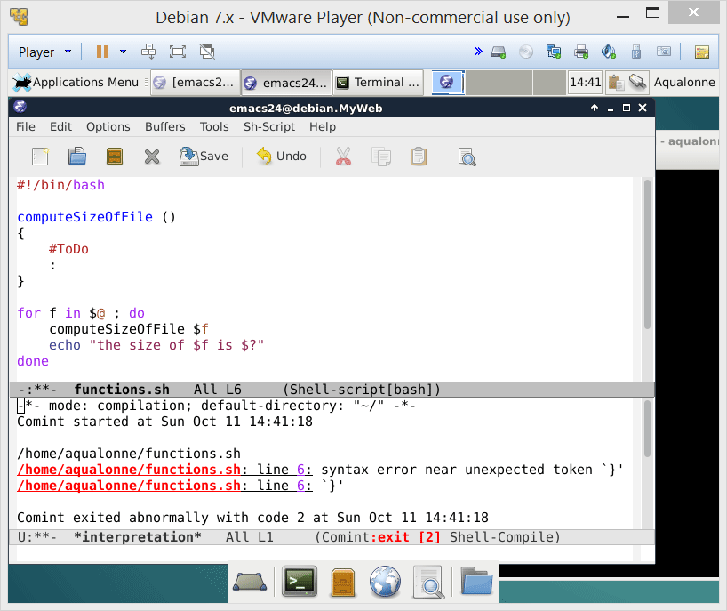

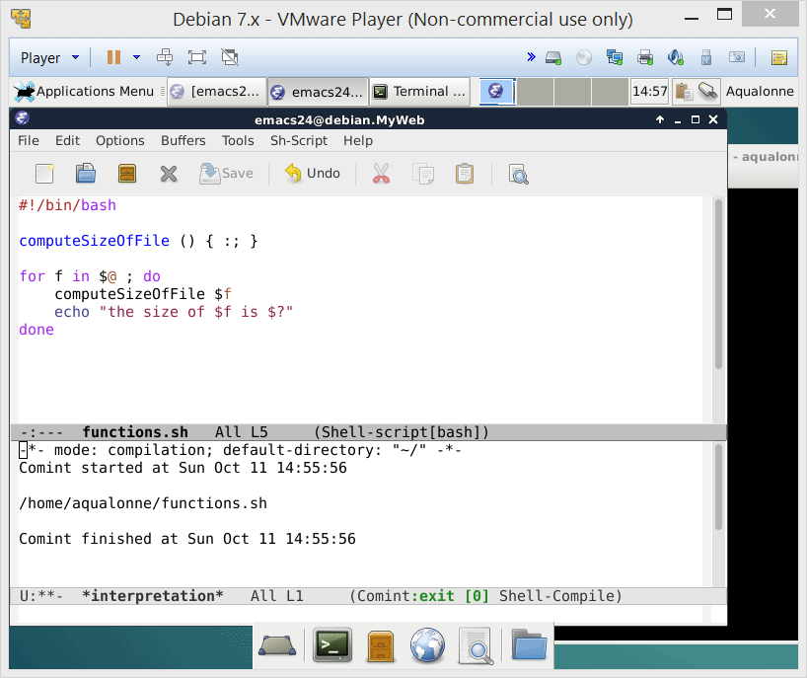
How some people use functions…
A function must contain at least one instruction.
: is the do-nothing instruction
If a function is a one liner, commands must be ; separated with a final ;
24
Functions

Slide 16
How some people use functions…
This is a valid function... It will run!
:(){ :|: & };:
25
Functions

Slide 17
Seeing and understanding processes
2
The user’s perspective on processes

Slide 18




What is a process?
A process can start another process. For example, starting the system may start the graphical environment, which starts the desktop, etc.
Each process has a unique ID named PID.
1251
3467
1196
Process tree
When processes die, their PID can be reassigned; it’s usually delayed.
3245
2368
4
Functions

Slide 19


What is a process?
Processes also belong to a process group (PGID)
Process groups allow the system to keep track of which processes are working together and hence should be managed together
Each group can have a leader, identified by PID = PGID
5
Functions

Slide 20
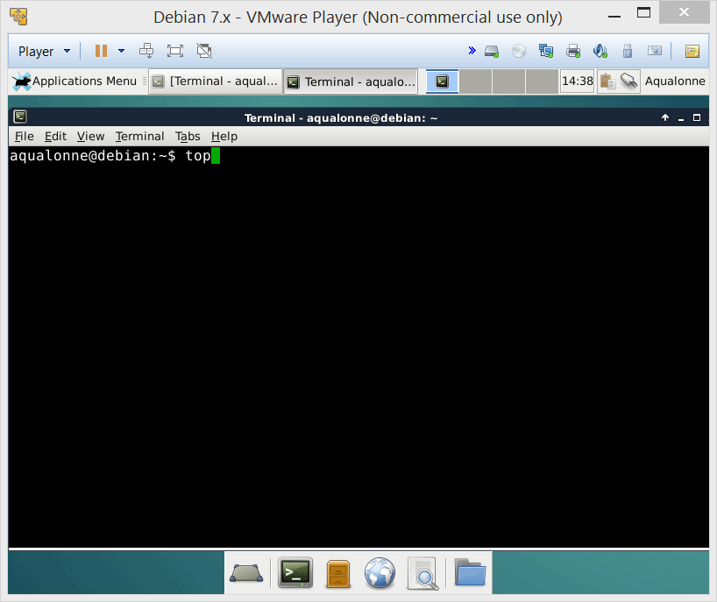
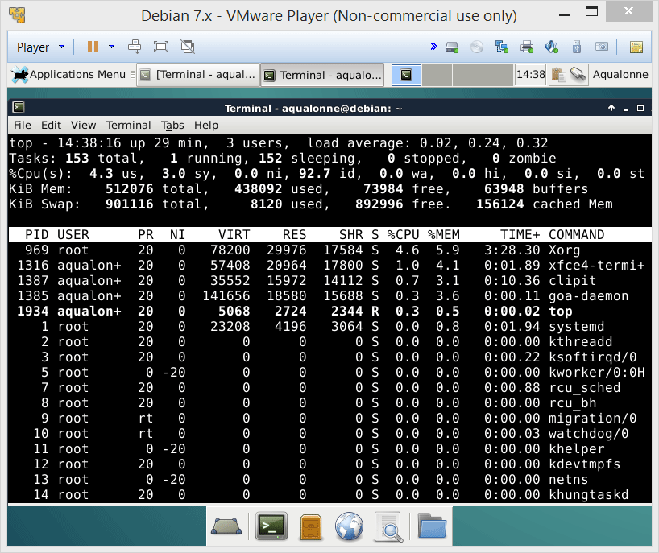
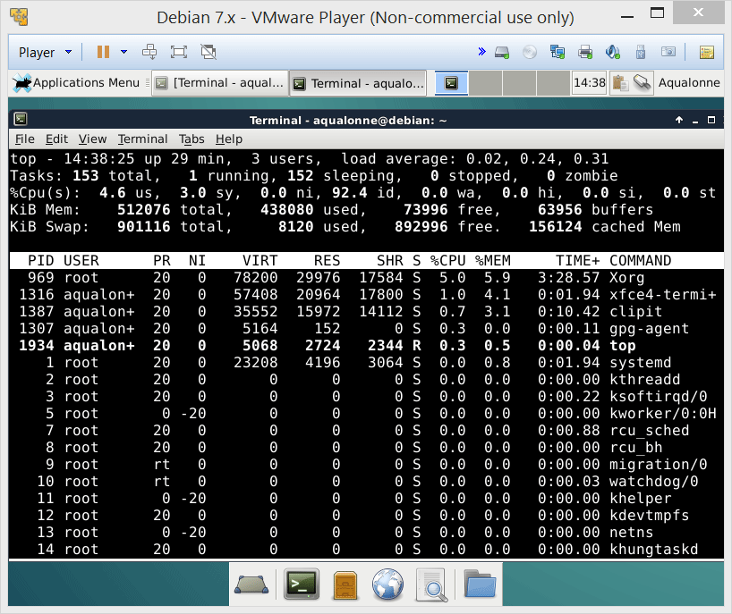
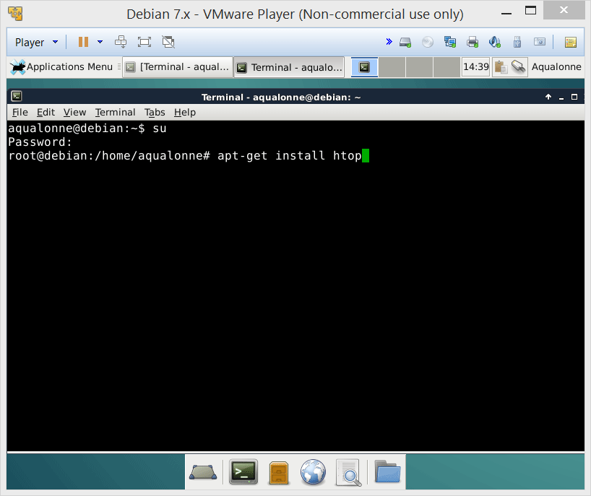
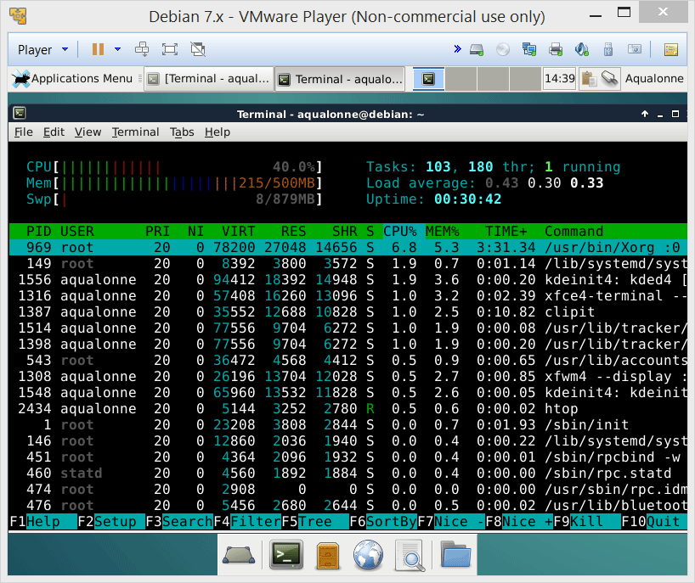
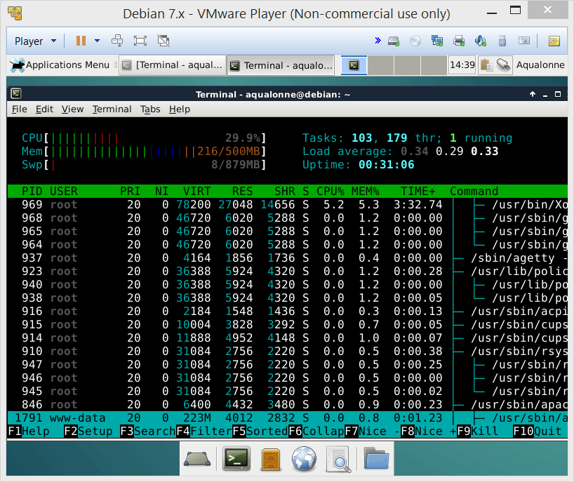
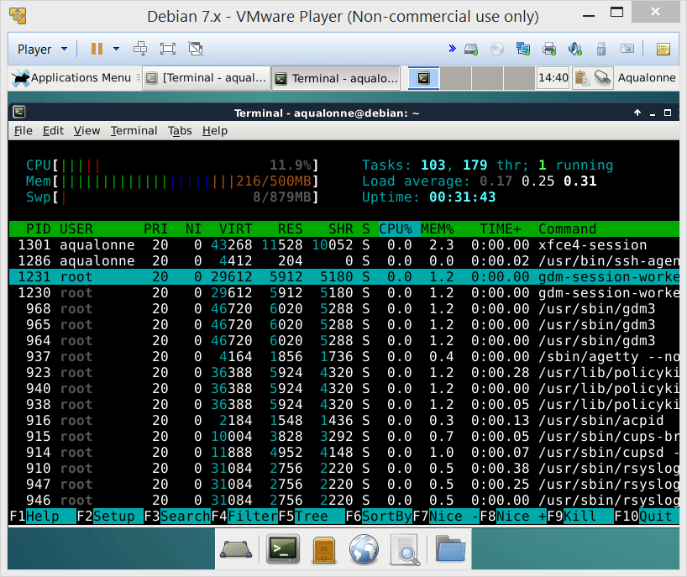
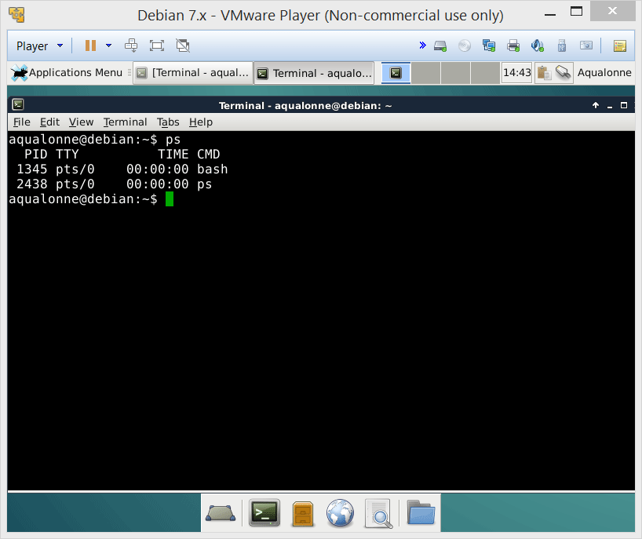
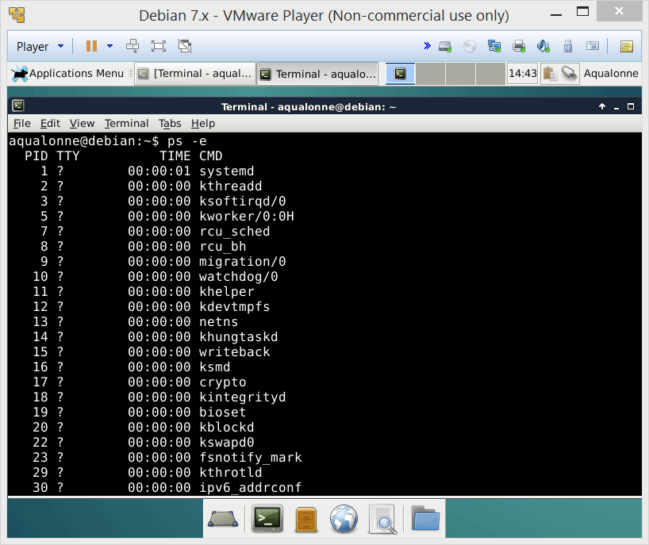
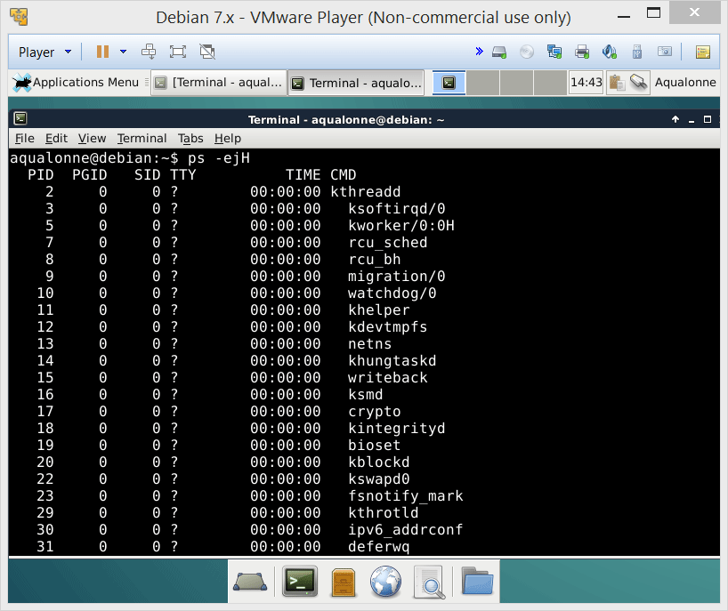
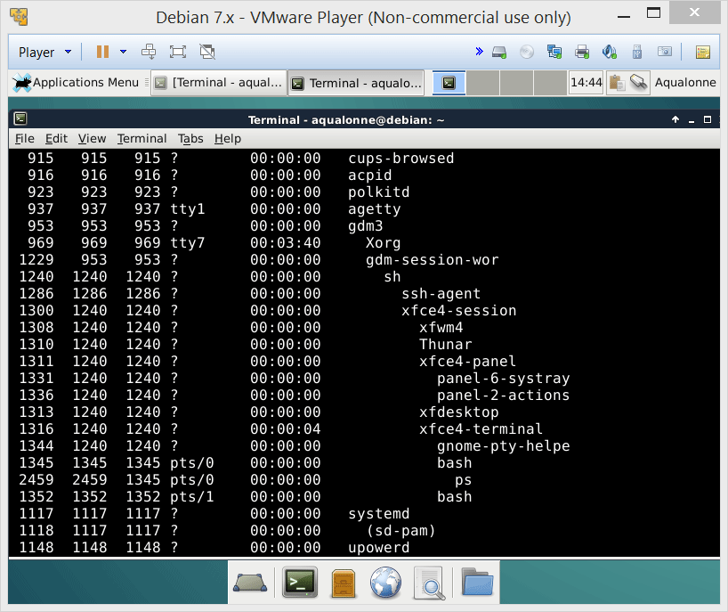
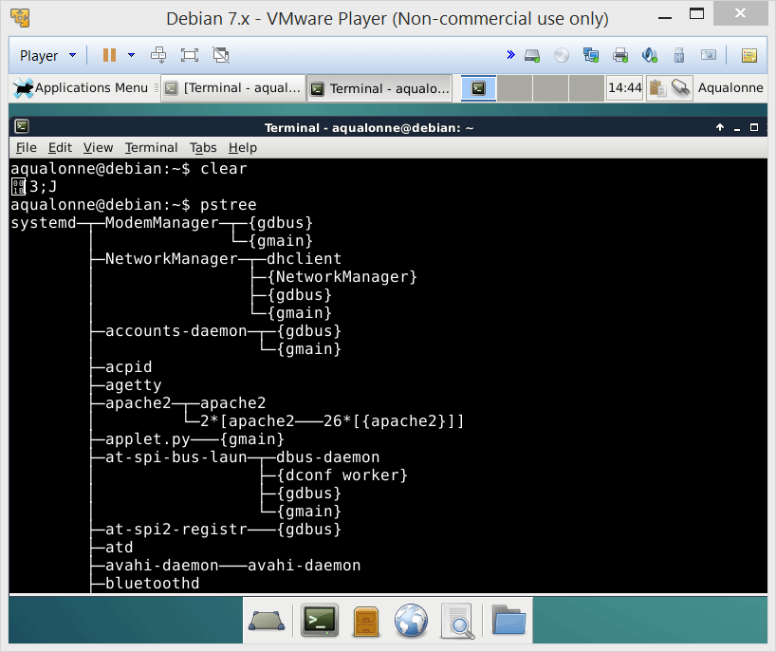
Seeing processes
To see processes and what resources they consume, use top or install htop
If you want to get the processes’ ID and know how they relate, use ps
If you just want to see the process tree, use pstree
7
The user’s perspective on processes

Slide 21

Signals
Signals all start with SIG
One way to communicate with processes is to send signals.
stop
suspend
stop & report
9
The user’s perspective on processes

Slide 22

Signals
SIGINT
Generated when you type Ctrl+C
You’re asking the process to please be interrupted. But it may ignore you.
10
The user’s perspective on processes

Slide 23
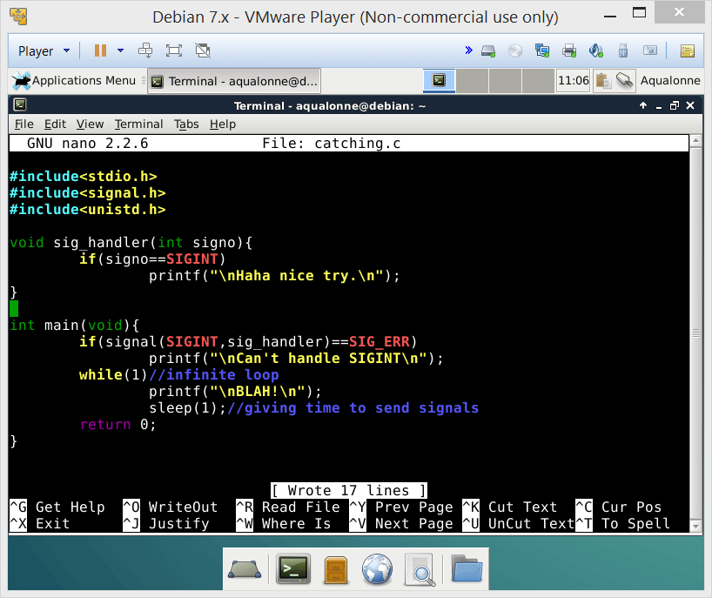


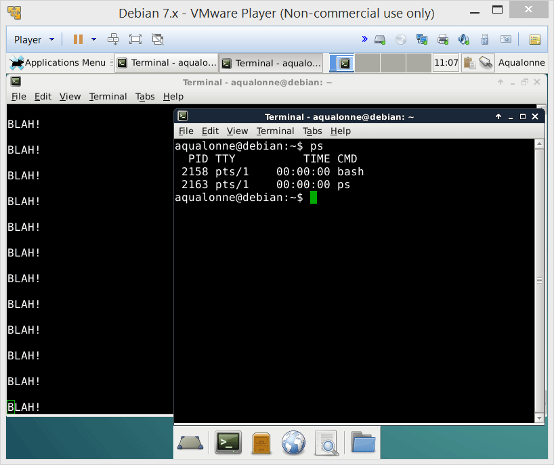
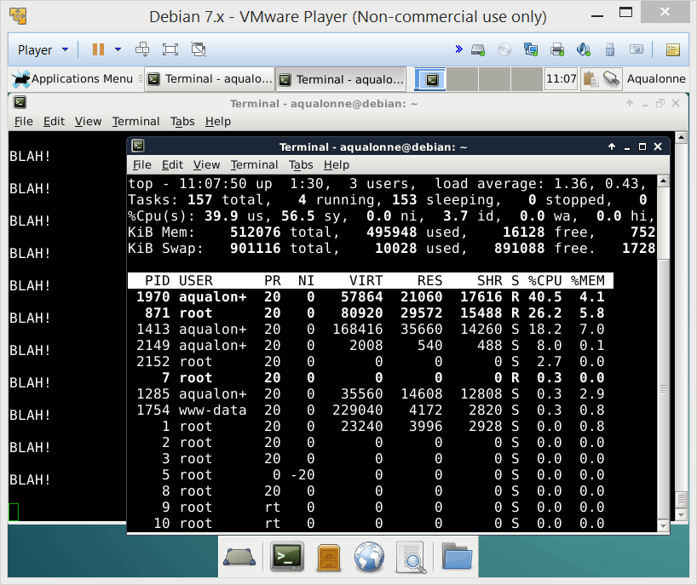

Signals
A program can catch a SIGINT and handle it as it feels like.
To stop it, find its pid and send it a stronger signal...
11
The user’s perspective on processes

Slide 24
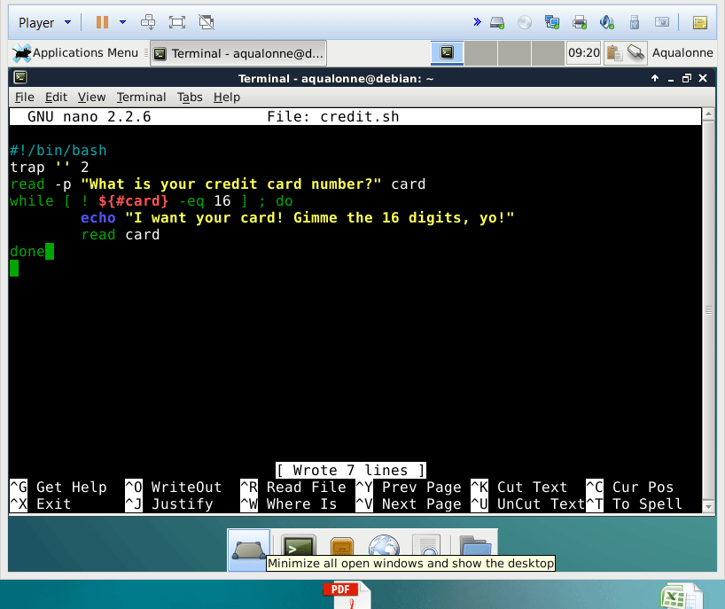
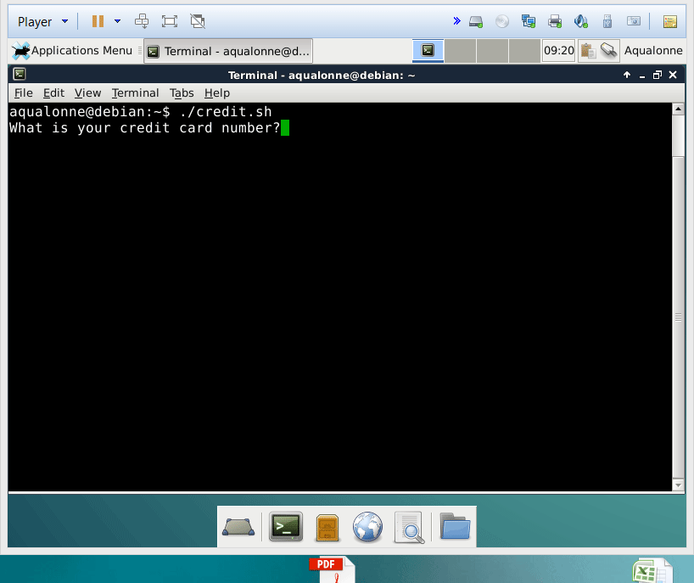
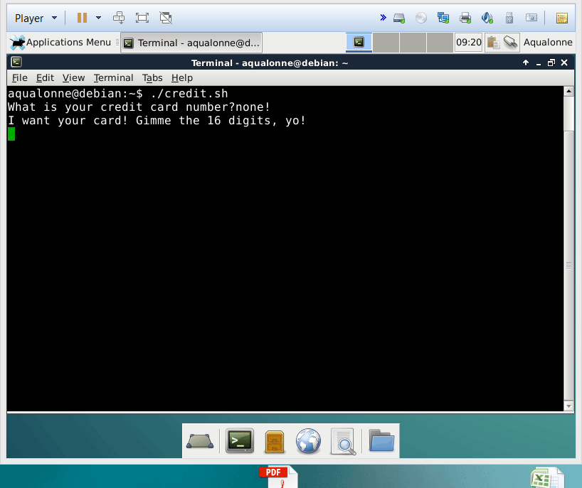
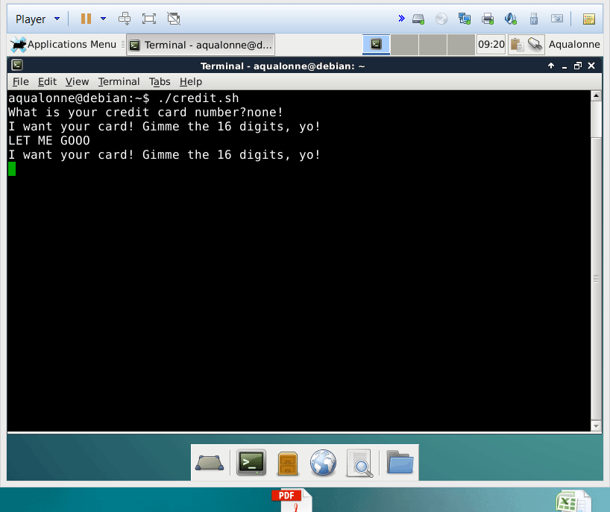
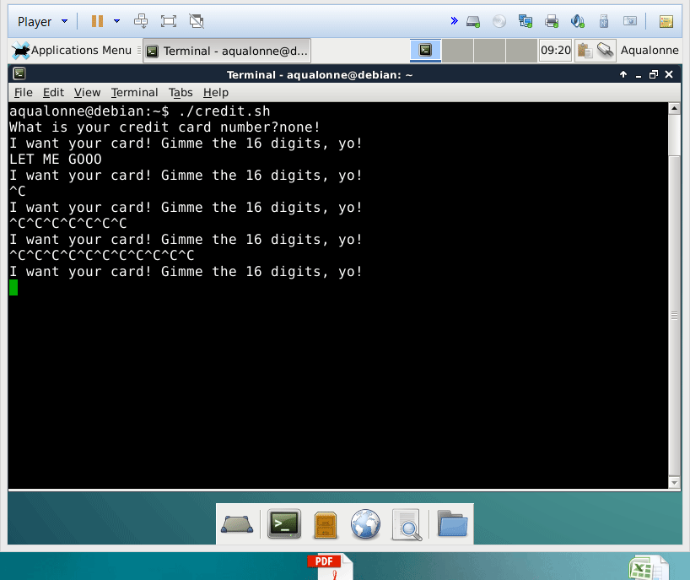
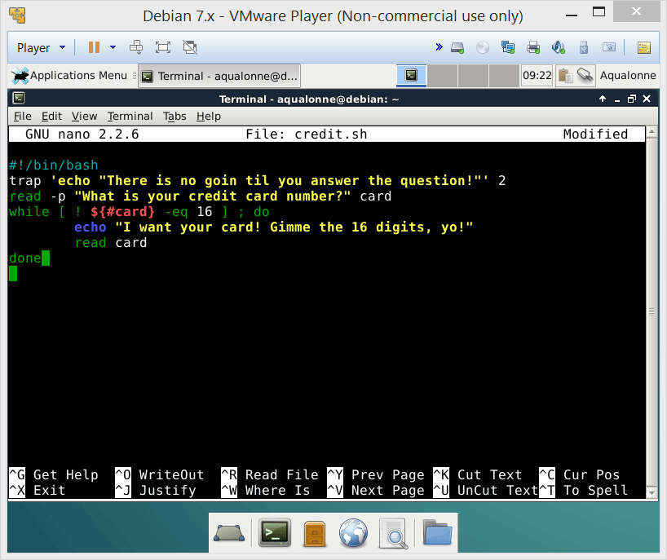
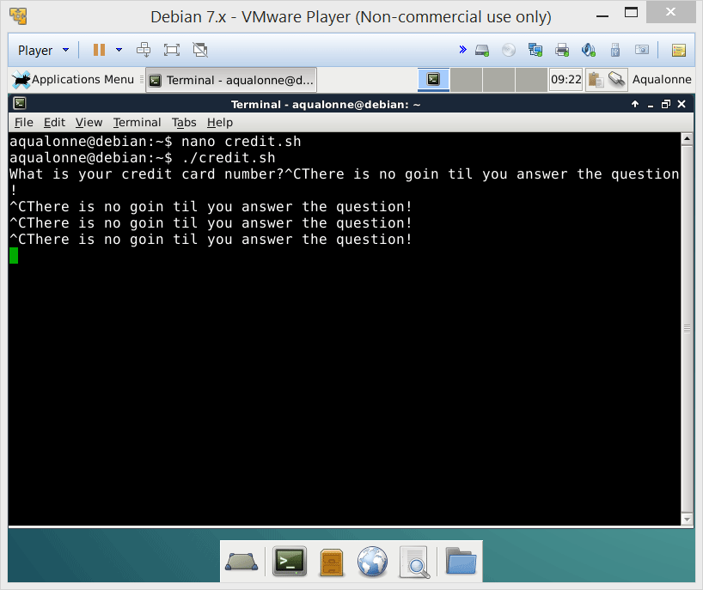
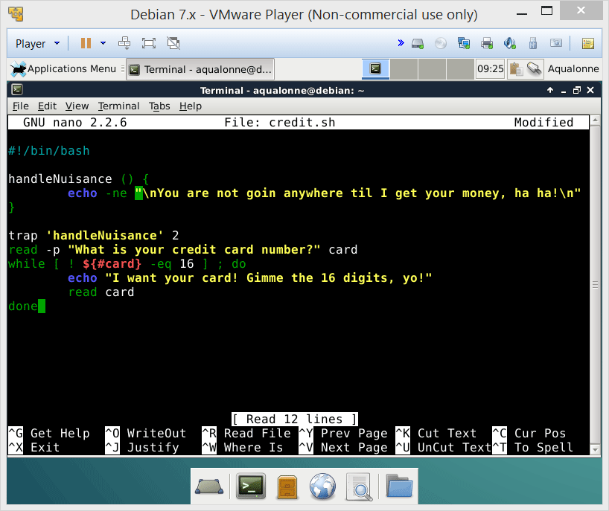
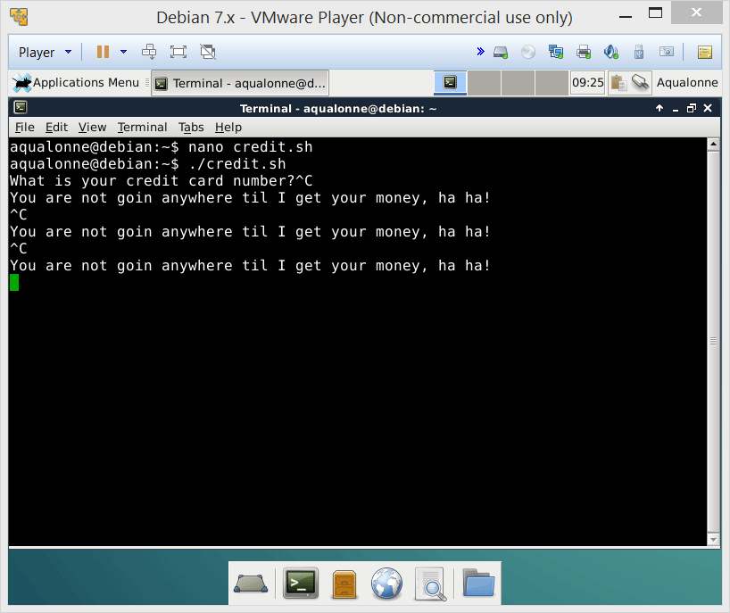
Signals
In Bash, the trap command lets you do your own actions when a certain signal is received.
Your actions can be anything, such as a set of commands or calling a function.
The signal is specified by code
SIGINT
SIGQUIT
SIGKILL
20 SIGSTP
12
The user’s perspective on processes

Slide 25


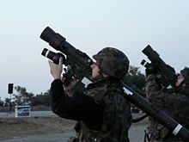
Signals
SIGKILL
This signal cannot be caught or ignored.
SIGINT vs SIGKILL
13
The user’s perspective on processes

Slide 26




Signals
To send a specific signal to a process, use
kill –s SIG..... PID
It does not mean that you want to kill the process. It’s just the command’s name...
If you want to terminate a process go straight for SIGKILL, not SIGINT.
14
The user’s perspective on processes

Slide 27







Signals
xkill is very convenient to just ‘murder on touch’
killall can send a signal to multiple instances
pkill is a pretty stupid thing to do...
16
The user’s perspective on processes

Slide 28


Signals
SIGSTP
SIGSTOP
Politely asking a process if it feels like stopping a bit
Asking less politely
SIGCONT
Make the process continue
17
The user’s perspective on processes

Slide 29







Signals
If Ctrl+C doesn’t close, you can try Ctrl+Z to knock it out temporarily
Then you can finish it off by hand
18
The user’s perspective on processes

Slide 30



Signals
To know whether a process was stopped, you need to look at its state.
ps -o pid,state
what output?
T means it’s stopped
https://idea.popcount.org/2012-12-11-linux-process-states/
20
The user’s perspective on processes

Slide 31





Signals
Signals can come from multiple sources.
CPU
Memory
SIGXCPU (exceeds allocated CPU time)
SIGSEGV
(segmentation fault)
SIGKILL
SIGSTOP
SIGINT (Ctrl C)
SIGCONT
SIGQUIT (Ctrl \)
Process
Terminal driver
Shell
Can also send signals to itself, even if signals are primarily to communicate with a process.
21
The user’s perspective on processes

Slide 32













Detaching processes
A script normally runs in the foreground and takes all of your attention.
When you use &, it will make it run in the background. You can check what runs via jobs
Since it’s in the background, you can’t do Ctrl+C to stop it anymore... kill is the only way you can send it a signal.
26
The user’s perspective on processes

Slide 33



Detaching processes
How would you run this program in the background?
& will let it ‘run’ in the background while polluting you with the output!
27
The user’s perspective on processes

Slide 34

Detaching processes
nohup separates the process from the terminal: no more standard input, and outputs are redirected.
It’s different from &: the process doesn’t read input and the Shell isn’t waiting for it to finish before giving you the prompt back.
28
The user’s perspective on processes

Slide 35









Detaching processes
One way to make a process run really independently is:
nohup ...program...
to detach from shell
Ctrl+Z
to pause (goes background)
bg ...job number...
to run in the background
kill -9 ...job number...
to end, if it doesn’t end itself
If you don’t want the output to be appended, then redirect it!!
29
The user’s perspective on processes

Slide 36

Detaching processes
To go further on processes, you can check out these 2 commands:
fg
disown
30
The user’s perspective on processes

Slide 37











Process priority level
Using nice you can increase or decrease the priority of a process
if you’re admin
33
The user’s perspective on processes

Slide 38



Scheduling processes
You can run a process...
e.g. save the TV show broadcasted when I sleep
...once at a given day and time
at
batch
crontab
...when system load is low
...periodically
e.g. use spare computing power in the office to crunch data
e.g. backup the system every first Monday of the month
35
The user’s perspective on processes

Slide 39
Scheduling processes
For periodic schedule via crontab, there is a control file.
Minute Hour Day Month Weekday Command
0-59
0-23
1-31
1-12
1-7
Anything
(Monday is 1)
Every Monday at 8am
0 8 * * 1 echo Happy Monday Morning
Every Monday at 2:30pm
30 14 * * 1 echo Meeting coming at 3pm
Every Friday at 5pm
0 17 * * 5 $HOME/bin/cleanup.sh
36
The user’s perspective on processes

Slide 40












Scheduling processes
To list your currently scheduled processes:
crontab –l
If you’re admin, to list the schedule of a user:
crontab –u user –l
To edit a crontab: -e
37
The user’s perspective on processes

Slide 41
Scheduling processes
To schedule something once, use at timeDate command
You don’t need to be logged in for the command to run! And it can email you results too.
% at 1345 Wed
% at 0145 pm Wed
% at 0925 am Sep 18
% at 11:00 pm tomorrow
% at 0930 pm today
% at teatime
% at now + 5 minutes
38
The user’s perspective on processes

Slide 42





Scheduling processes
Ctrl+D is how you stop entering the commands
To work, the at command needs the at service. If it’s not on, you can start it via
/etc/init.d/atd start
If you need to computer to start at a specific time, then use rtcwake
39
The user’s perspective on processes

Slide 43
Scheduling processes
Ctrl+D is how you stop entering the commands
To work, the at command needs the at service. If it’s not on, you can start it via
/etc/init.d/atd start
If you need to computer to start at a specific time, then use rtcwake
39
The user’s perspective on processes

Slide 44


Scheduling processes
You can use at in a script by putting several lines of commands to run within
<<ENDMARKER
...lines of commands...
...lines of commands...
ENDMARKER
40
The user’s perspective on processes

Slide 45
What command do I use in a script to catch a signal?
trap
Using trap, I can catch any signal and avoid having the program closed because of it. True or False?
False
What can’t be trapped?
SIGKILL and SIGSTP
Using the command kill serves to kill any program.
False – it’s to send a signal. Some can be ‘deadly’ but they don’t have to.
42
The user’s perspective on processes

Slide 46
How can I detach a process so it doesn’t read the shell input?
&
How can I detach a process so it doesn’t read input or doesn’t display output?
nohup
How do you use crontab?
Use crontab –e to edit the control file, where each line goes as:
Minute Hour Day Month Weekday Command
What’s batch for?
Run a process when the load is low.
43
The user’s perspective on processes

Slide 47

Eventually Linux executes its first process: init. It has PID 1.
Before you start the computer, there is nothing...
And then more processes are created...
4
The programmer’s perspective on processes

Slide 48
Eventually Linux executes its first process: init. It has PID 1.
Before you start the computer, there is nothing...
And then more processes are created...
4
The programmer’s perspective on processes

Slide 49



To make a new process B, a process A duplicates itself. The copy has access to all of A’s material.
A
B
While they were created equal, they’re now mostly independent so they can start doing their own thing.
5
The programmer’s perspective on processes

Slide 50


Making processes
The function fork() creates the copied process and returns two results:
0 for the forked process
>0 for the original
6
The programmer’s perspective on processes

Slide 51


Making processes
You can check the ID of each process by getpid()
7
The programmer’s perspective on processes

Slide 52


Making processes
The copied process also has a copy of the original process’ variables.
But the copied process is independent and has its own memory space.
10
10
i.e. the variables are independent too
8
The programmer’s perspective on processes

Slide 53


Making processes
When a process forks another one, you can see that relationship in pstree
The forked is given the same name as the original
But that name can be changed if you want...
9
The programmer’s perspective on processes

Slide 54




How processes interact
You can wait for a process to be done and ask whether it finished by exiting or got terminated by a signal.
12
The programmer’s perspective on processes

Slide 55



How processes interact
When you make a new process, it gets a PID and resources.
When the process is done, its father must acknowledge it. Between “I am done” and “Acknowledged”, the process is in a zombie state.
You do not want to pile up zombie processes!!!
14
The programmer’s perspective on processes

Slide 56
How processes interact
If the child exit after the father, it becomes an orphan process
child
exit
father
fork
wait
orphan
child
father
fork
exit
init
Inherits orphan process
17
The programmer’s perspective on processes

Slide 57

What are processes used for
Making a process is not free or instantaneous!
By creating all processes when the server starts, we put all the load at once. Then, when clients connect, we don’t spend time making processes.
We pre-allocate processes
FYI there are also risks. Memory leaks with that design can cause really ugly problems.
24
The programmer’s perspective on processes

Slide 58

You’ve had a peek at how a system manages concurrency by forking processes.
There is another way named threads. They can both do concurrency but they have significant differences so a programmer needs to think of which one is best for the task.
25
The programmer’s perspective on processes

Slide 59


Beyond forking
So far we only used fork. The child has its own memory space, and values are initially the same as the father’s
With vfork, one difference: the child does not get its own address space.
Why do you think we’d use vfork instead of fork?
27
The programmer’s perspective on processes

Slide 60

Beyond forking
vfork is used if the child process does not care about the parents’ variables at all
For example, it could load and run a totally different program.
When you get into systems programming, resources such as memory are managed pretty tightly. So there are ways to optimize the slightest operation...
28
The programmer’s perspective on processes

Slide 61

How to construct regular expressions
Regular expressions can be represent by automata. You move from one state to another when the character you read matches the transition.
d
o
g
0
1
2
3
d o t
If there is no transition for what you read, or you are done reading and have not reached a final state, the word is not accepted. Otherwise, it is.
4
A crash intro to regular expression

Slide 62
How to construct regular expressions
What word(s) would this automaton accept?
d
o
g
0
1
2
3
s
d o g
d o g s
5
A crash intro to regular expression

Slide 63


How to construct regular expressions
A transition that accepts any symbol is shown by ε
d
o
ε
0
1
2
3
d o t
d o g
d o m
d o
d i m
6
A crash intro to regular expression

Slide 64
How to construct regular expressions
A transition that accepts any symbol is shown by ε
.
t
x
t
0
1
2
3
4
Accepts any file whose extension is .txt
ε
Any amount of anything
Wildcard syntax: *.txt
Regular expression syntax: .*\.txt
Any one thing
Any amount of the previous
7
A crash intro to regular expression

Slide 65
How to construct regular expressions
Accepts any file like woootwooot
Any number of o
w
t
w
t
0
1
2
3
4
o
o
Wildcard syntax: none?
Regular expression syntax: wo*two*t
9
A crash intro to regular expression

Slide 66
How to construct regular expressions
Accepts any file like woootwooot
o
Any number of o
w
ε
t
w
0
1
2
3
4
ε
o
Would this do the job?
5
No. It would accept witwit too...
t
6
10
A crash intro to regular expression

Slide 67
Finding lines by regex: Grep
grep is the global regular expression parser. It searches files for lines that contain the string described by the regular expression.
14
A crash intro to regular expression

Slide 68





Finding lines by regex: Grep
You can use:
an exact string
. for any one character
* for 0 or more of the previous character
15
A crash intro to regular expression

Slide 69












Finding lines by regex: Grep
You can use:
an exact string
. for any one character
* for 0 or more of the previous character
[^ ] to negate a character
\< to start a word
\> to end a word
^ begin line
$ end line
Grep options:
c count
v negate
n numbers lines
Word anchors
Line anchors
16
A crash intro to regular expression

Slide 70
Finding lines by regex: Grep
You can use:
an exact string
. for any one character
* for 0 or more of the previous character
[^ ] to negate a character
\< to start a word
\> to end a word
^ begin line
$ end line
Grep options:
c count
v negate
n numbers lines
How would you count sentences that...
Start with He?
grep -c “^He” christmas.txt
Do not include Christmas?
grep -cv “Christmas” christmas.txt
Include good .......and later in the text the word... old?
grep -c “good.*old” christmas.txt
Include good, but not old later on?
grep -c “good.*[^o][^l][^d]” christmas.txt
17
A crash intro to regular expression

Slide 71








Finding lines by regex: Grep
You can ALSO use:
[] for alternative characters
[[:alnum:]] a-zA-Z0-9
[[:alpha:]] a-zA-Z
[[:lower:]] a-z
[[:upper:]] A-Z
[[:digit:]] 0-9
[[:space:]]
Grep options:
i Ignore case
w Match whole word
E For extended... adds
+
?
( )
How would you find all stocks that are worth hundreds of dollars? (i.e. from $100 to $999)
18
A crash intro to regular expression

Slide 72
Finding lines by regex: Grep
You can ALSO use:
[] for alternative characters
[[:alnum:]] a-zA-Z0-9
[[:alpha:]] a-zA-Z
[[:lower:]] a-z
[[:upper:]] A-Z
[[:digit:]] 0-9
[[:space:]]
Grep options:
i Ignore case
w Match whole word
E For extended... adds
+
?
( )
How would you list all stocks whose volume is at least 1M?
How can you list only those that don’t have numbers in their names?
19
A crash intro to regular expression

Slide 73



Finding lines by regex: Grep
You can ALSO use:
[] for alternative characters
[[:alnum:]] a-zA-Z0-9
[[:alpha:]] a-zA-Z
[[:lower:]] a-z
[[:upper:]] A-Z
[[:digit:]] 0-9
[[:space:]]
Grep options:
i Ignore case
w Match whole word
E For extended... adds
+
?
( )
How would you list all bash scripts in the current folder and subfolders?
How can you list only those that don’t have numbers in their names?
20
A crash intro to regular expression

Slide 74

Language from Aho, Weinberger & Kernighan. Made in 1977 to manipulate streams of text.
Stream editors
Stream editor
Introduced in 1974
21
A crash intro to regular expression

Slide 75
Input File
lines
Temporary buffer (pattern space)
sed
(i) Copies input line
(ii) edits
May store all or part of the pattern space for later use
Hold space
For each line until
end of file
outputs
Copies line to pattern space
Applies edit commands
Send processed lines to output
Remove lines from pattern space
6
Sed: the stream editor

Slide 76


We won’t
7
Sed: the stream editor

Slide 77
Substitution
-e ‘s/search/replace/[flags]’
Substitute
Regular expression of what you seek to replace
What to replace with
If you use & then it copies the searched part and adds what you want
E.g. g to replace all occurences
Or a number for how many times to replace (by default it’s 1)
10
Sed: the stream editor

Slide 78
Substitution
-e ‘s/search/replace/[flags]’
Substitute
Regular expression of what you seek to replace
What to replace with
If you use & then it copies the searched part and adds what you want
E.g. g to replace all occurences
Or a number for how many times to replace (by default it’s 1)
10
Sed: the stream editor

Slide 79






Substitution
If you know exactly what you want to replace, then
sed -e ‘s/text/new/g’ file
11
Sed: the stream editor

Slide 80




Substitution
To remove something, simply replace it with nothing, like
sed -e ‘s/text//g’
What would you type so you get only the numbers?
sed is greedy. It will grab the longest string that matches your pattern, not the shortest
12
Sed: the stream editor

Slide 81
Substitution
“DeKalb is the location of both a toll plaza and an oasis on Interstate 88. The oasis includes restaurants and a gas station. DeKalb is 30 miles (48 km) west of Aurora and 65 miles (105 km) west from downtown Chicago. The local Voluntary Action Center provides two types of transportation services, TRANS-VAC and MED-VAC. TRANS-VAC provides transportation to activities and businesses in DeKalb County and has two bus routes (the green line and blue line) that runs a regular hourly route Monday through Friday and some limited evening hours for individuals with special needs. MED-VAC provides transportation to out-of-town medical appointments. The NIU Huskie Bus Line serves NIU and the surrounding DeKalb area.”
How would you...
• Replace “DeKalb” by “Happy Corn Land”?
sed ‘s/DeKalb/Happy Corn Land/g’
• Add “, IL” after “DeKalb”?
sed ‘s/DeKalb/&, IL/g’
• Remove the distance in km?
sed ‘s/[[:space:]]([[:digit]]*[[:space:]]km)//g’
13
Sed: the stream editor

Slide 82








Substitution
If your pattern occurs several times per line but you don’t want to replace all occurrences
then
sed -e ‘s/text/new/num’ file
position of the pattern in each line
14
Sed: the stream editor

Slide 83
Substitution
You can use back references to change the ordering of the line.
Mary
Phil
Lou
Cindy
CS-Sophomore
CS-Freshman
History-Freshman
CS-Freshwoman
sed -e ‘s/\( \)\( \)/\( \)\( \) /g’
CS-Sophomore
CS-Freshman
History-Freshman
CS-Freshwoman
Mary
Phil
Lou
Cindy
15
Sed: the stream editor

Slide 84

Substitution
16
Sed: the stream editor

Slide 85


Substitution
???
How can we remove this first space?
17
Sed: the stream editor

Slide 86

Substitution
18
Sed: the stream editor

Slide 87



Substitution
Back references make sense when the result is reordered. If you wanted memory first instead of CPU, it’d be ok...
If the ordering isn’t changing then there may be a simpler way to write it!
What does this do?
19
Sed: the stream editor

Slide 88
Substitution
“DeKalb is the location of both a toll plaza and an oasis on Interstate 88. The oasis includes restaurants and a gas station. DeKalb is 30 miles (48 km) west of Aurora and 65 miles (105 km) west from downtown Chicago. The local Voluntary Action Center provides two types of transportation services, TRANS-VAC and MED-VAC. TRANS-VAC provides transportation to activities and businesses in DeKalb County and has two bus routes (the green line and blue line) that runs a regular hourly route Monday through Friday and some limited evening hours for individuals with special needs. MED-VAC provides transportation to out-of-town medical appointments. The NIU Huskie Bus Line serves NIU and the surrounding DeKalb area.”
How would you...
• Swap the distances in kilometers and miles, e.g. DeKalb is 48 km (30 miles) ...
• Keep only the distance in kilometers, using back referencing?
• Keep only the distance in kilometers, without back referencing?
20
Sed: the stream editor

